Slide 1



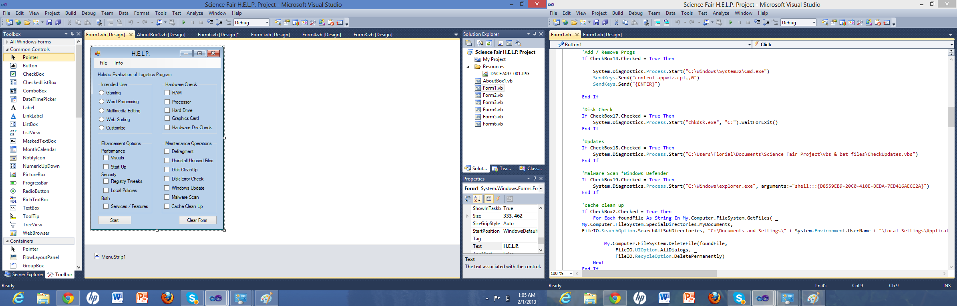
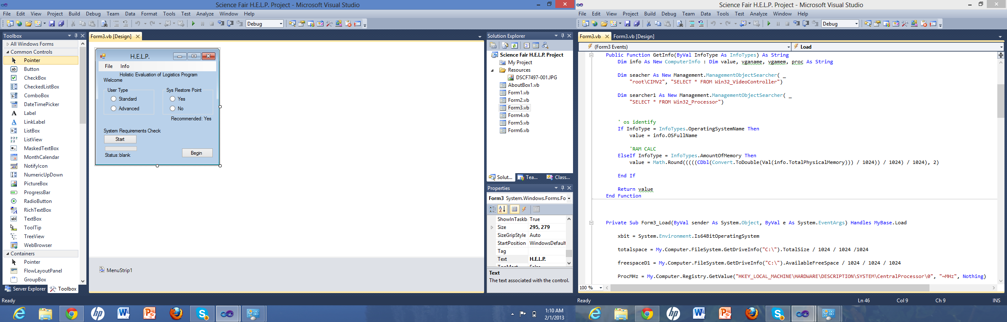

Holistic Evaluation of Logistics Program (H.E.L.P.)
Andrew Florial
User Interaction
Start: Form 3
(User Input)
-Select user knowledge base
-Settings back up option
-Run system requirements check
-Primary Diagnostic Page: Form 1
-Select user group (User Input)
-Enhancement options (User Input)
- Performance / Security / Both
-Hardware Check (Automated)
-Maintenance options (Automated)
Secondary Diagnostic Page: Form 2
Define enhancement options:
Visual adjustments (User Input)
Local policies (Automated)
Registry tweaks (Automated)
Boot time (User Input)
Tertiary Diagnostic Page: Form 4
Select User Type
Services Selection (User Input/Automated)
Quaternary Diagnostic Page: Form 5
Data management selection
-ReadyBoost Config (Automated)
-Write Cache option (User Input)
Quinary Diagnostic Page: Form 6
-Feature Selection (User Input)
Senary Diagnostic Page: Form 7
-Registry specification
Methods used to identify performance enhancement
Frame rate
-Games
-Windows frame rate
Computation speed
-Save time
-Application load
Windows performance monitor (overall)
-Time duration
-System start up
-App start up
-Navigation
-Render time
Methods used to identify security enhancement
-Security score rating
-Vulnerability count (MBSA)
The purpose of this experiment is to personalize the OS, based upon usage and function to redefine settings, policies, and configuration to maximize system security, performance, data and memory proficiency within user defined parameters.
It is hypothesized that If user defined input regarding usage, function, and preference undergoes evaluation and is managed to reconfigure system settings, appropriate system resources, and formulate user specific suggestions then system security, performance, data and memory usage can be optimized accordingly.
Performance can be ubiquitously increased 10%.
Security rating can be increased significantly.
Unnecessary data management can be improved 5%
Septenary Diagnostic Page: Form 8
-Hardware driver update (Automated)
Program Functions
Performance Procedures
Adjust Visuals
Disabling windows aero
Disable windows visual effects
Disable determine necessity of potentially unnecessary services
Disable error reporting-
Fax and printing service-
HomeGroup listener-
HomeGroup Provider-
IP helper-
Network access protection agent-
Offline files (business and ultimate edition only)-
Ready boost-
Disable newer hard drives 7200 RMP
Enable older hard drives 5400 RMP
Remote assistance
Search indexing-
Smart Card-
Smart card removal policy-
Tablet PC components-
Tablet PC Input Service-
Windows internet printing client
Windows media center receiver service
Windows media center scheduler service
Windows media player network sharing service
Security procedures
Additional security of disabling potentially unnecessary aforementioned services and features.
Configuring local policies
Disable autoplay on portable storage devices
Disabling guest account
Identifying and disabling used network connections and shares
Performing malware scan
Removing remote access and controls
Suggestive Information
Back up data
Password complexity
Screen saver
Tweaking registry values
Updating Windows and policy
Uninstalling unnecessary windows Features
Games
Media Features
Printing and document services
Remote differential compression
Tablet pc components
Windows gadget platform
Windows search
XPS Services / XPS Viewer
abs
As the program becomes more refined, and data collection and analysis are improved including the incorporation of system logs, automation of optimization based on the use of the system can be accurately identified. Reducing performance degradation by automating exact maintenance essentials therefore also saving time. Increasing performance overall by exacting usage and system necessities to reduce system resource consumption enabling computational power to be reserved for specific usage. Allow the system heightened flexibility by providing usage recalibration in regards to performance, security and data management. Reducing the need for costly technical servicing. Active security bulletin monitoring, adjustments for security optimization.

